Slide 1
Project
Loose Connection defect Reduction in OEGPL W/Heater
Onkar Engine & Generator Pvt. Ltd., Noida

Slide 2
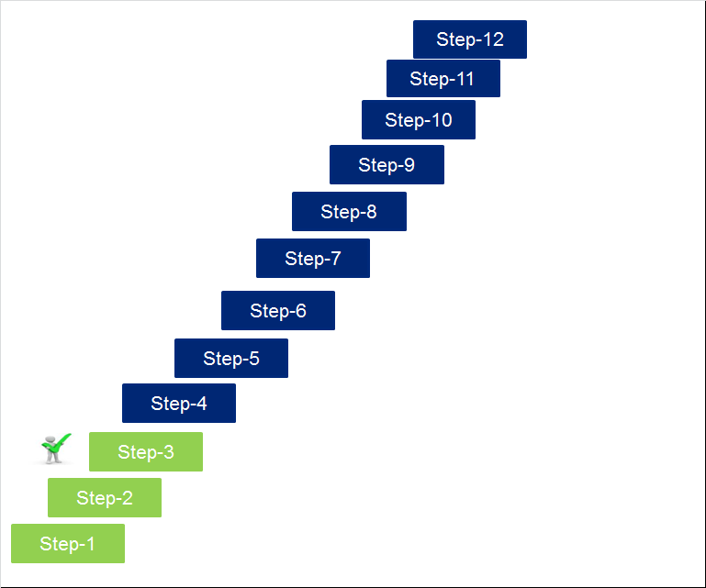
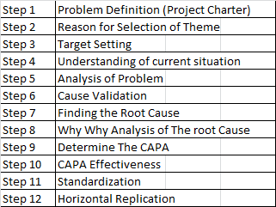
12 Steps Problem Solving Methodology
Project : Loose Connection Reduction in OEGPL Water Heater

Slide 3
Step 01: Problem Definition ( Project Charter)
Crompton Greaves Consumer Electricals Ltd. |  | CI PROJECT CHARTER | CI PROJECT CHARTER
Project Name : Reduction of Loose Connection Defects in 20** & 24** series water heater
Project Start Date: 01.07.2021 |  |  |  | Project End Date: (Implementation) of CAPA; Target Completion Date: 31- June -2023
Problem statement: Loose Connection contributes 2.59 % of the total customer complaints (PPR) in Onkar Water heater, (Based on PPR Data FY2020-21)
Goal Statement : Reduce Heating element Failure in Onkar water heater from 2.59% to 1.95% (i.e. reduction by 25%) by June 2023
Complaint Details : Loose Connection
CTQ Definition : Water heater not “ON” |  |  |  | CTQ metric : Skilled Operator, Thimble dimensions & Specs, Crimpling Load
Project Scope
Product scope : All Water Heater SKUs manufactured by OEGPL Noida |  |  |  | Process Scope : Geyser Assembly
Team member (Supplier, Vendor, Customer, Support staff)
Sr. | Name |  |  | Initials
1 | Mr. Anand Prakash EGPL |  |  | AP
2 | Mr. Kumar Saurabh - OEGPL |  |  | KS
3 | Mr. Prashant Band – Crompton - Service |  |  | PB
4 | Mr. Sachidanand Singh Crompton – Design |  |  | SS
5 | Mr. Mayank Dobhal - Crompton Quality |  |  | MD
6 | Mr. Rakesh Upreti –Crompton - Sourcing |  |  | RU
Project benefits : 1. Improvement in connection wire thimbles Reduction in Rework. 2 Reduction in Market complaints due to robust product design & process improvements. 3. Reduction in COPQ
Project Sign off :

Slide 4
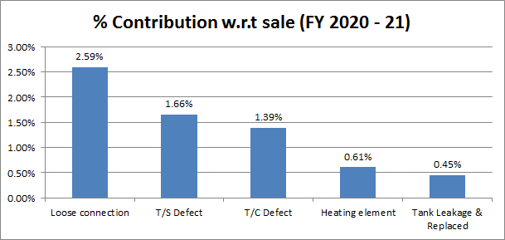
Step 02: Reason for selection of theme
Defect Analysis @ Crompton
Project Selection
Project With other supplier
Project under Monitoring
Detailed Analysis to next slides on GOC

Slide 5
Step 02: Reason for selection of theme
GRC Defect Analysis @ OEGPL (FY 2020- 21) Amica 20** Series
Particular | Frequency | Cumulative Frequency | Cumulative%
Tank Leakage | 601 | 601 | 42
Dent & Damage | 480 | 1081 | 76
Complaint missing | 336 | 1417 | 100
A | No leakage against Tank Leakage
B | Leakage against Tank Leakage
C | Leakage from Element Assembly
D | Other model Element used against Tank Leakage
E | Other party Geyser
F | H/W loose after Ele Replacement

Slide 6
Step 02: Reason for selection of theme
GRC Defect Analysis @ OEGPL (FY 2020- 21) Qube 24** Series
Particular | Frequency | Cumulative Frequency | Cumulative%
Dent & Damage | 420 | 420 | 60%
Complaint Missing | 147 | 567 | 81%
Tank Leakage | 131 | 698 | 100%
A | No leakage against Tank Leakage
B | Leakage from Element Assembly
C | Leakage against Tank Leakage
D | H/W loose after Ele Replacement
E | Other model Element used against Tank Leakage
F | Other party Geyser

Slide 7
Step 3 : Target Setting
25%

Slide 8
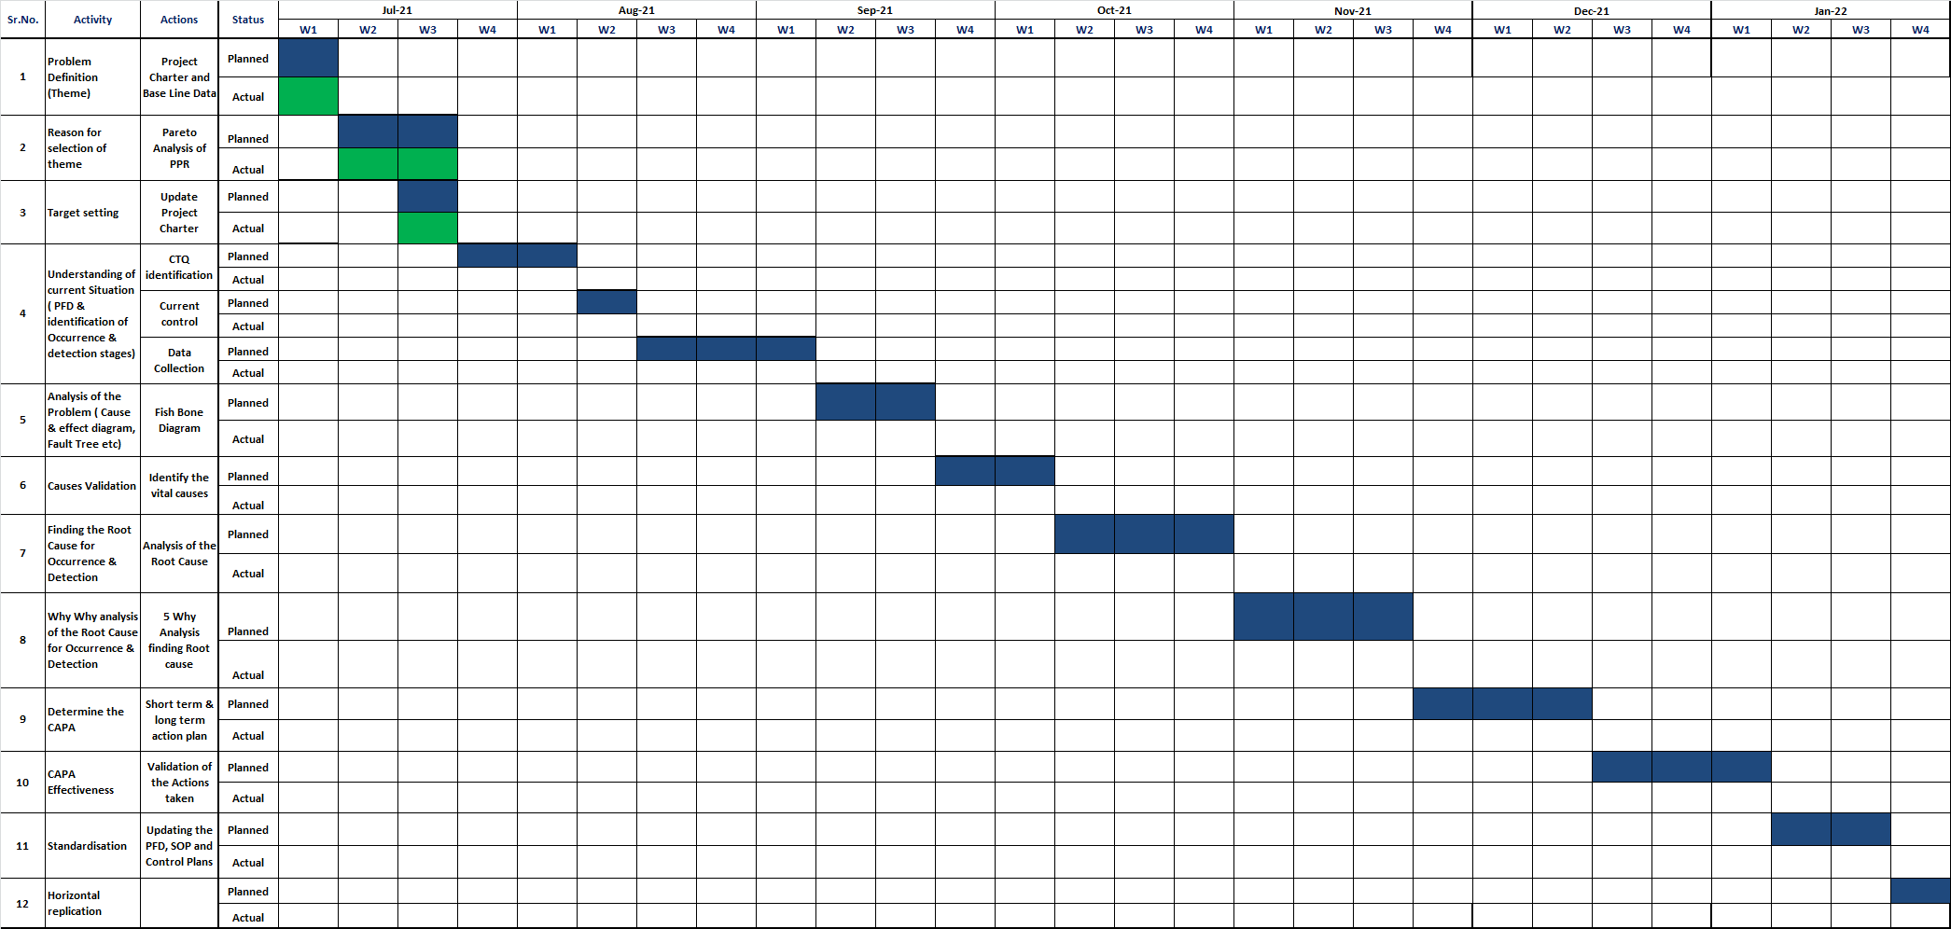
Project Time plan

